Slide 1

Credit Card Fraud Detection
Internship Project By:-Mohammad Adnan Khan BMS College of Engineering

Slide 2

Introduction
Analyzing historical transaction data to detect patterns and anomalies indicating fraudulent activity.

Slide 3

Machine Learning

Slide 4
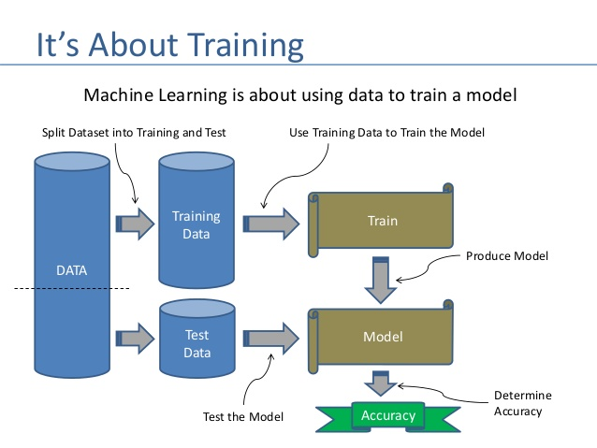

Slide 5
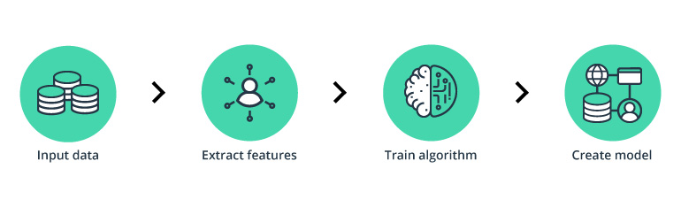
Fraud Detection Steps

Slide 6

Dataset Acquirement
GitHub
DataCamp
Kaggle

Slide 7
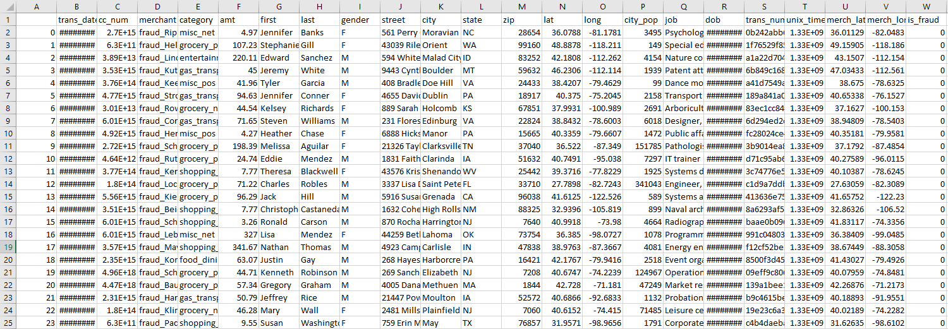
Dataset (Before Extracting the Features Required)

Slide 8
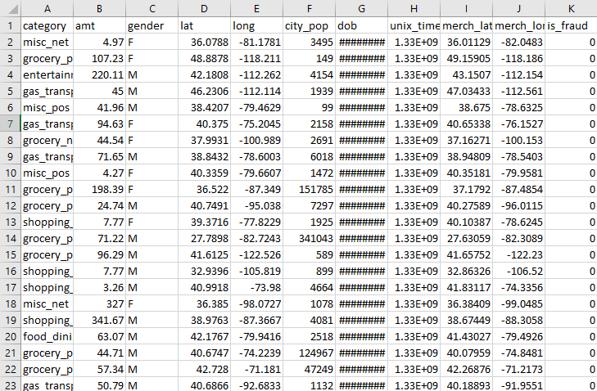
Dataset (After Extracting the Features Required)

Slide 9
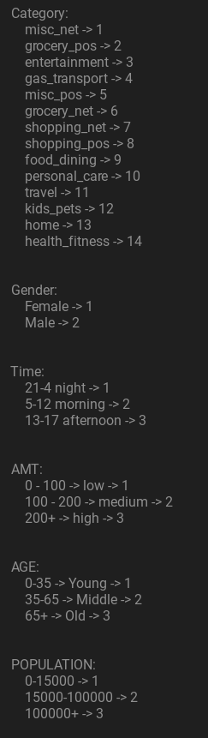
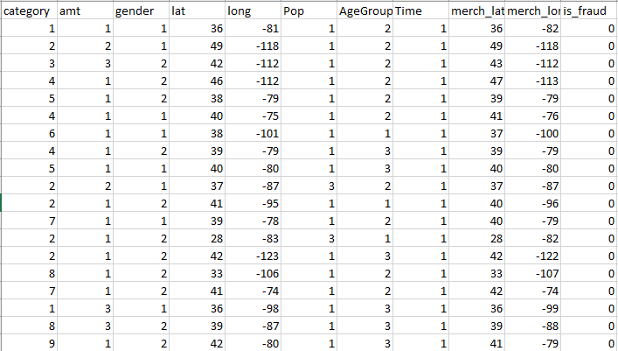
Dataset (Label Encoding)

Slide 10
Machine Learning Model Used:
Artificial Neural Networks (ANN)
Binary Classification Model

Slide 11
Results (Model Accuracy)
Artificial Neural Network Algorithm- (94.87%)

Slide 12
Technologies Used
Pytorch (Training and Building the ML Model)
Kivy/KivyMD (UI)
scikit-learn (Data Scaling)
PostgreSQL (Storing Dataset)
Pandas (Loading Dataset)

Slide 13
Demo

Slide 14
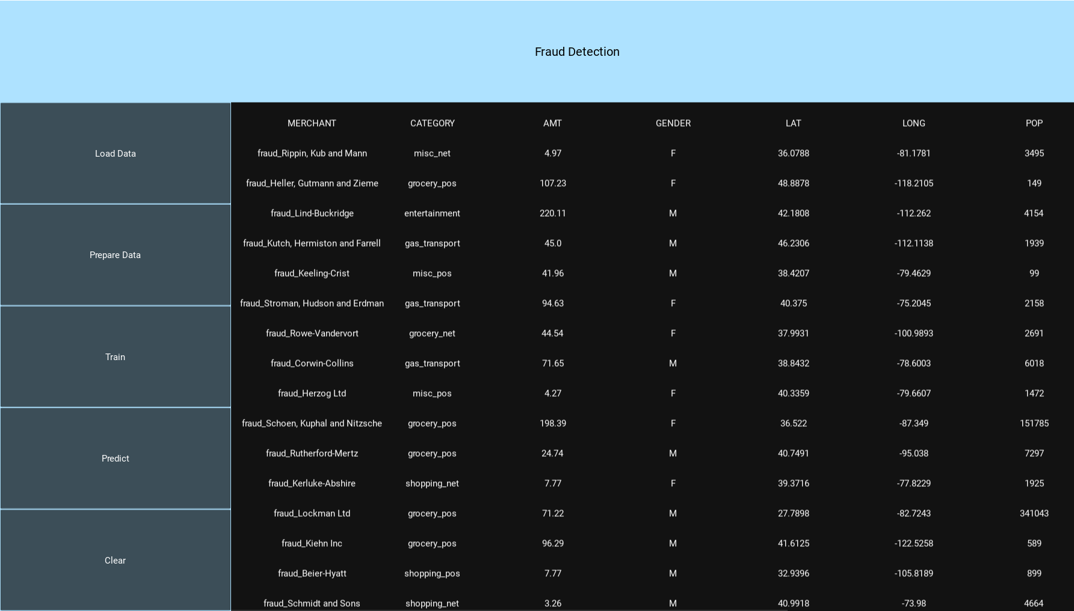
Loading Unprepared Data

Slide 15
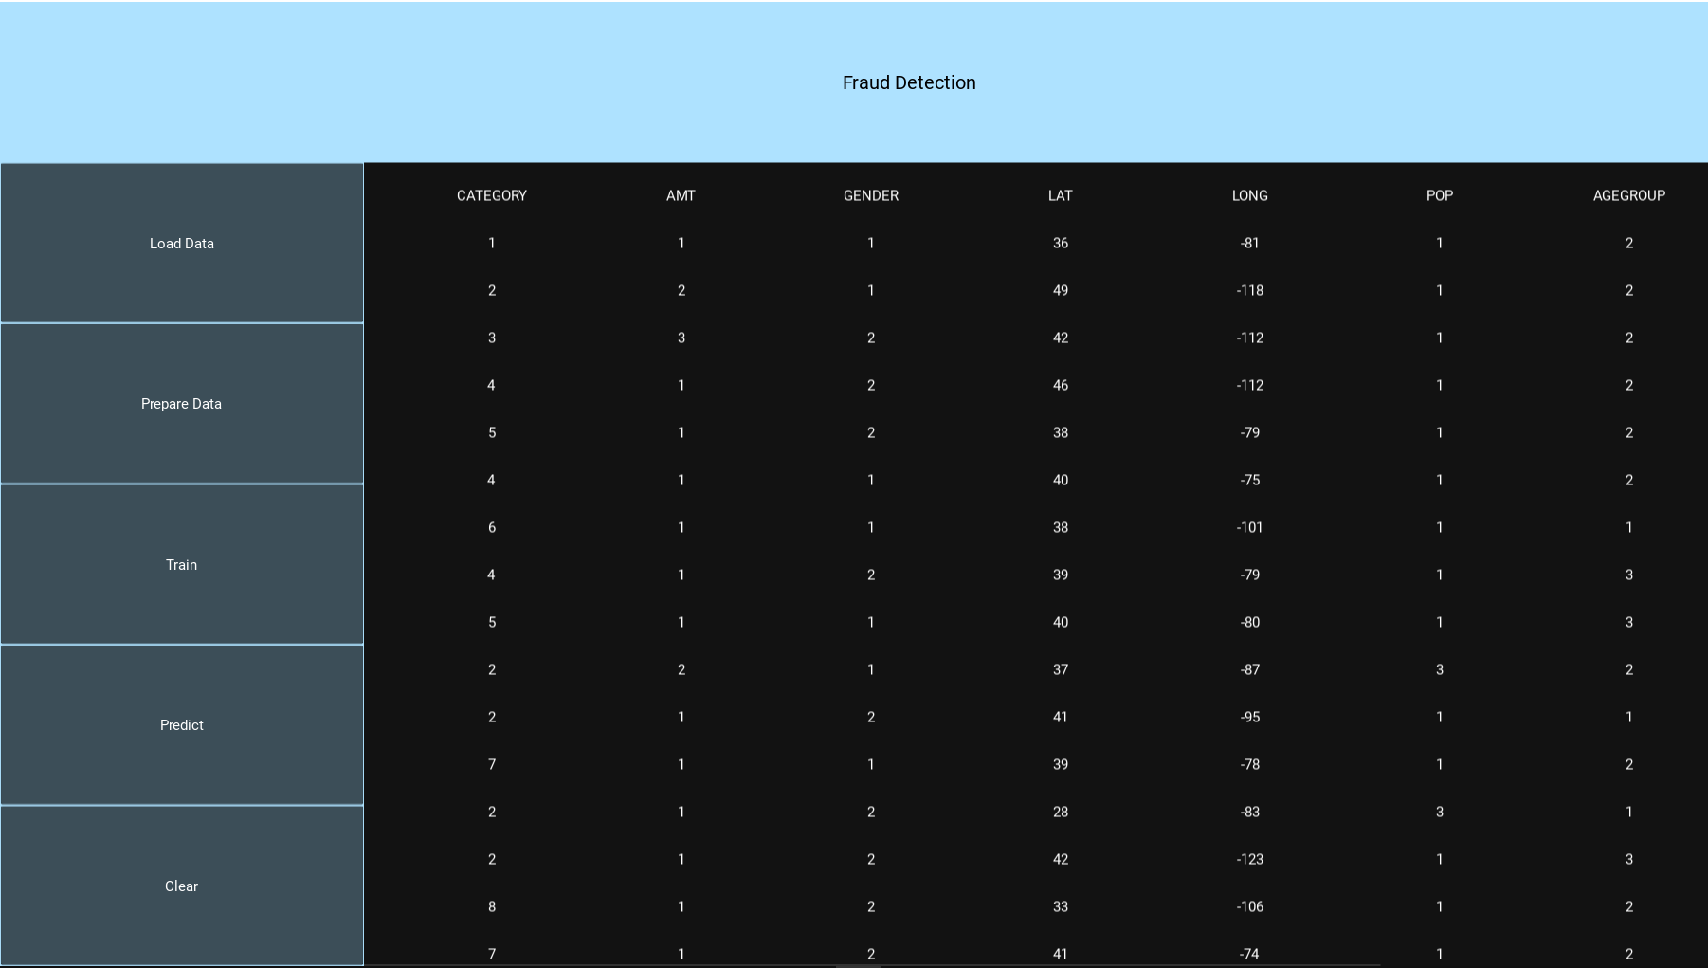
Loading Prepared Data

Slide 16
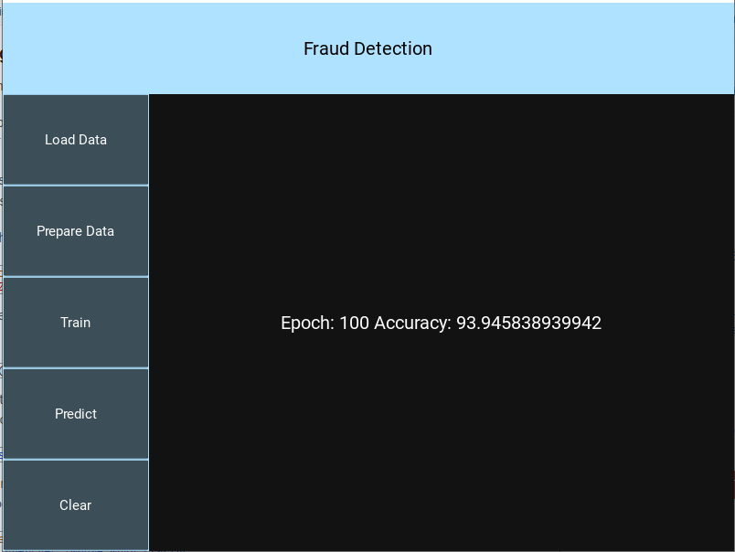
Training the Model

Slide 17
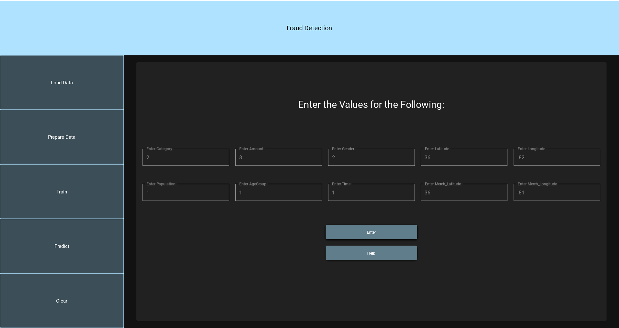
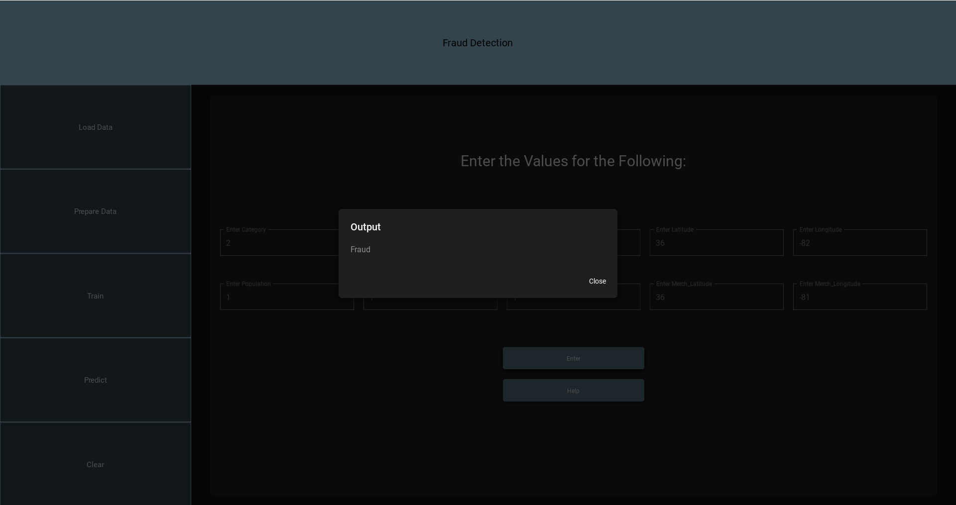
Prediction

Slide 18
Questions ?

